Slide 1
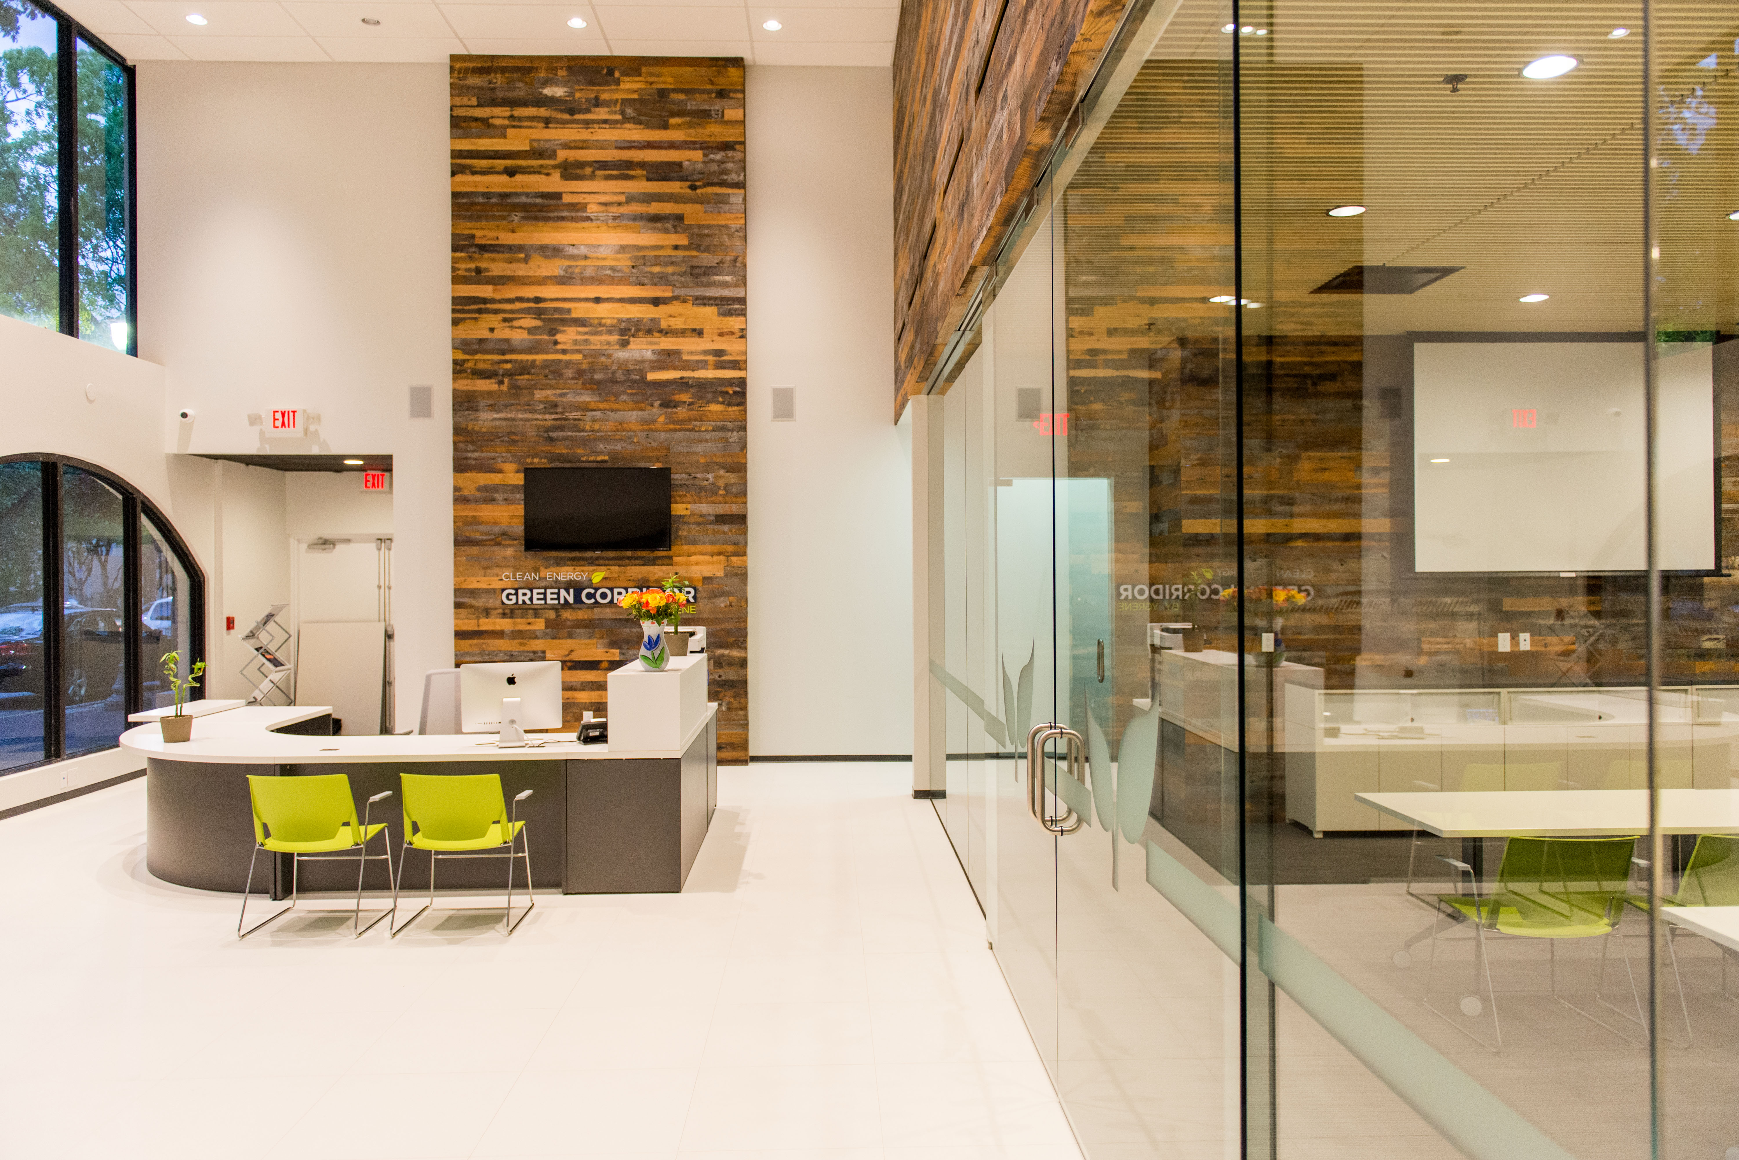
CLEAN ENERGY GREEN CORRIDOR
RAFAEL PEREZ, REGIONAL MANAGER

Slide 2
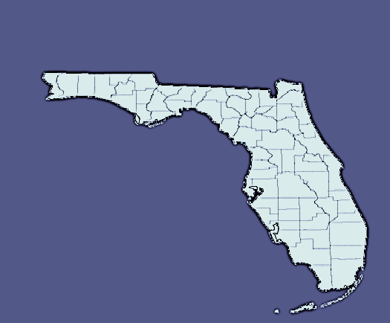
WHAT IS PACE?
Property Assessed Clean Energy
Its a new Financing option Available to Property Owners. FL. State Statue 163.08 allows…
How does PACE WORK……..
Municipalities join together and create a District to Finance these upgrades.
Inter-local Agreement (Piggyback)

Slide 3


WHAT IS CLEAN ENERGY GREEN CORRIDOR?
CORAL GABLES
CUTLER BAY
MIAMI
MIAMI SHORES
PALMETTO BAY
PINECREST
SOUTH MIAMI
KEY BISCAYNE
BISCAYNE PARK
BAY HARBOR ISL.
SURFSIDE
NORTH BAY VILL.
+
=

Slide 4
ELIGIBLE PROPERTY OWNERS
MIN. 10% EQUITY ON PROPERTY, MAX LTV 100%
CURRENT ON PROPERTY TAXES FOR LAST 3 YEARS
CURRENT ON MORTGAGE FOR LAST 12 MONTHS
NO BANKRUPTCY IN THE LAST YEAR
1
2
CRITERIA
3
4
Notes:
Use Johnson quote to launch into “how we got here”:
Ygrene won a competitive bid process in Sept. of last year and will be the City’s SOLE PACE Administrator for a period of at least five years. (Public/private partnership)
Expand on current status (i.e. when is funding available?)

Slide 5
ELIGIBLE PROPERTIES
INDUSTRIAL
COMMERCIAL
NON-PROFIT
MULTI-FAMILY RESIDENTIAL
SINGLE-FAMILY RESIDENTIAL
(MIAMI ONLY DISTRICT #2 and #4)
Notes:
Use Johnson quote to launch into “how we got here”:
Ygrene won a competitive bid process in Sept. of last year and will be the City’s SOLE PACE Administrator for a period of at least five years. (Public/private partnership)
Expand on current status (i.e. when is funding available?)

Slide 6




ELIGIBLE IMPROVEMENTS
ENERGY EFFICIENCY
RENEWABLE ENERGY HURRICANE PROTECTION
WATER CONSERVATION

Slide 7
ELIGIBLE IMPROVEMENTS
ENERGY EFFICIENCY
Air sealing and ventilation
Air filtration
Building envelope
Duct leakage and sealing
Bathroom, ceiling, attic, and whole-house fans
Insulation
Defect correction
Attic, floor, walls, roof, ducts
Weather-stripping
Sealing
Geothermal exchange heat pumps
HVAC systems
Evaporative coolers
Natural gas storage water heater
Tankless water heater
Solar water heater system
Reflective insulation of radiant barriers
Cool roof
Windows and glass doors
Window filming
Skylights
Solar tubes
Additional building openings for natural light
Lighting
Pool equipment
Occupancy sensor lighting fixtures
SMART parking lot bi-level fixtures
SMART parking garage bi-level fixtures
SMART pathway lighting
SMART wall-pack fixtures
Task ambient office lighting
Classroom lighting
Refrigerator case LED lighting
Wireless daylight lighting controls
Kitchen exhaust variable air-volume controls
Wireless HVAC controls & fault detection
GENERATION
Solar thermal hot water systems
Solar thermal systems for pool heating
Photovoltaic systems
Emerging technologies
CUSTOM MEASURES
Fuel cells
HVAC duct zoning-control systems
Building energy-management systems
Industrial- and process-equipment motors/controls
Irrigation pumps and controls
Lighting controls
Natural gas
Hydrogen fuel
Wind-turbine power system
Other fuel sources (emerging technology)
Co-generation (heat & energy)
WIND RESISTANCE
Roof deck & foundation strength improvements
Secondary water barrier
Wind-resistant shingles or other roofing
Gable-end bracing
Roof-to-wall connection reinforcement
Storm shutters
Perimeter-opening protections
Raising building elevations

Slide 8
WHAT ARE THE BENEFITS TO THE CITY?
100% FINANCING
No out of pocket expense to property owner
Removes single largest obstacle to implement these projects
VOLUNTARY
Simply an option for those who want it
All traditional forms of financing are still available
INDIVIDUAL
Zero affect on neighbors
Only those who choose to participate pay the assessment
NON CREDIT BASED
Eligibility based on property values and owner equity
Allows many to participate that would not be eligible for traditional financing

Slide 9
BENEFITS TO PROPERTY OWNERS
ELIMINATE UP-FRONT EXPENSE
NOT CREDIT BASED LONG PAYBACK PERIODS
PAYMENTS MAY STAY WITH PROPERTY
OFF BALANCE SHEET (Commercial Properties)
POTENTIAL FOR REAL SAVINGS

Slide 10
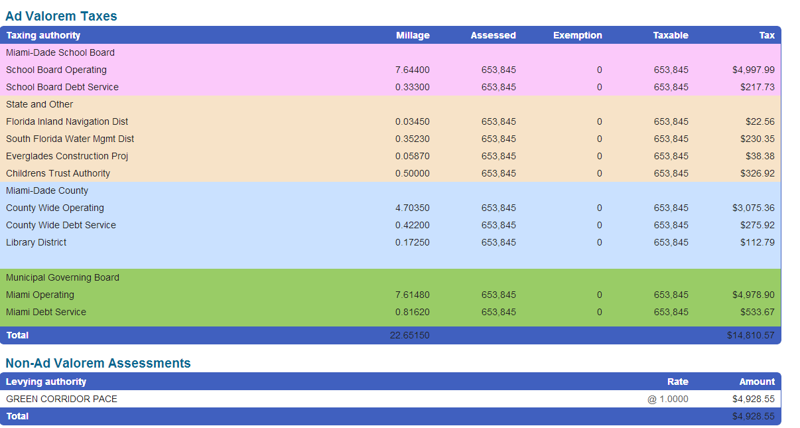
Property Tax Bill

Slide 11
HOW DOES THE PROCESS WORK?
Notes:
Three categories of projects qualify for Clean Energy Sacramento financing:
Energy efficiency, renewables and water efficiency.
“If it saves energy or water, or creates energy, then it qualifies for CES”
Examples: Solar PV, Solar thermal, HVAC systems, Lighting, Water heaters, windows, cool roofs, insulation, chillers/freezers, industrial equipment and motors, low-flow toilets and water fixtures.

