Slide 1


Your Benefits Enrollment Guide
City of Miami Springs
FLHKW8BEN
Notes:
Hello and welcome to your benefits presentation with Humana.

Slide 2

Welcome to Humana
At Humana, we want to help take care of you — with benefits that make it easy for you to get the care you need, when you need it. Whether it's through preventive care at no additional cost, wellness and personal care programs, or 24/7 virtual visits, your care is at the core of what we do.
Notes:
At Humana, We want to help take care of you, with benefits that make it easy for you to get the care you need, when you need it. Whether it’s through preventive care at no additional cost, wellness and personal programs, or 24/7 virtual visits, your care is at the core of what we do.

Slide 3

Today’s discussion
Plan highlights and features:
Medical plan options
What else comes with your plan
Vision plan options
Notes:
In Today’s Discussion…..

Slide 4

Medical plan options
Notes:
Let’s discuss your Humana medical plan options.

Slide 5
To see if your doctor is in the network, go to Humana.com/findadoctor and select the network(s) listed below.
Medical plan options
 | Deductible | Coinsurance | Maximum out-of-pocket | Preventive care | Copays | Pharmacy | Network
HMO Bronze Plan | Individual $1,500 Family $3,000 | N/A | Individual $5,000 Family $10,000 | 100% | Primary Care: $25 Specialist: $50 Telemedicine: $25 Urgent Care: $75 Emergency Room: $350 | Tier 1: $10 Tier 2: $40 Tier 3: $70 Tier 4: 25% | HMO Premier
HMO Silver Plan | Individual $750 Family $1,500 | N/A | Individual $2,250 Family $5,500 | 100% | Primary Care: $25 Specialist: $50 Telemedicine: $25 Urgent Care: $50 Emergency Room: $100 | Tier 1: $10 Tier 2: $35 Tier 3: $60 Tier 4: 25% | HMO Premier
HMO Gold Plan | Individual $0 Family $0 | N/A | Individual $1,000 Family $3,000 | 100% | Primary Care: $15 Specialist: $15 Telemedicine: $15 Urgent Care: $25 Emergency Room: $50 | Tier 1: $10 Tier 2: $35 Tier 3: $50 Tier 4: 25% | HMO Premier
NPOS | Individual $750 /Family $1500 In- Network Individual $1,500 /Family $3,000 Out-of- Network | 80% In-Network 60% Out-of-Network | Individual $2,750/Family $5,500 In-Network Individual $5,500/Family $11,000 Out-of-Network | 100% In-Network 40% Out-of-Network | Primary Care: $20 Specialist: $20 Telemedicine: $20 Urgent Care: $50 Emergency Room: $100 | Tier 1: $10 Tier 2: $35 Tier 3: $60 Tier 4: 25% | NPOS
Benefits shown are for in-network services

Slide 6

What else comes with your plan?
Notes:
What else comes with your plan?

Slide 7


Doctor On Demand®
With our Doctor On Demand® app, you can see a board-certified doctor for non-emergency care from your home, office or while you’re traveling in the United States. For everyday health needs, Doctor On Demand® usually costs less than a visit to the emergency room or urgent care.
Doctor On Demand® | Your visit cost
Everyday health concerns Colds, flu and sore throat Upper respiratory infections Skin and eye problems Urinary tract infections Prescriptions and refills Labs and screenings | $10-$55
Mental health services Depression Stress Anxiety Trauma Other non-emergency mental health concerns | Your cost for a mental health visit will vary based on your plan. You’ll know the cost of your visit when you schedule your appointment.
Notes:
Doctor on Demand.
Doctor on Demand allows you to see a board-certified doctor for non-emergency care from your home, office or while you’re traveling in the United States. Doctor on Demand usually costs less than a visit to the emergency room or urgent care and allows you to address everyday health concerns such as; colds, flu, prescription refills and addresses mental health services. (attaching the Doctor on Demand flyer to your presentation and direct members to review for additional information).
Alternative : Your medical plan options provide $0-$56 virtual visit services to you and to your covered dependents. By downloading the Doctor on Demand mobile application, you will have access to board-certified doctors for non-emergency care 24 hours a day, 7 days a week, at any location of your choosing. Whether you are traveling or you need care after hours, Doctor on Demand is available for your non-urgent needs.
Virtual visits are also available for mental health services and costs will vary based on your plan but will be known at time of appointment.

Slide 8




Go365®
Getting healthier can be easier and lots more fun with Go365®. When it comes to health and wellness, you have your own approach.
One that works for you. Go365® can make it easier to get moving along your personal path to health and wellness.
Unlock activities
Receive activities personalized to help you reach your health goals, no matter where you are on your journey to better health. Just unlock your activities and earn points for higher status.
Earn rewards
The higher you move up in status, the more bucks you can earn and spend on great items in the Go365® Mall, like Amazon and Target gift cards, athletic gear, and more.
Stay inspired
Tracking your activity is a breeze—just connect your compatible apps or fitness devices and earn points for all your healthy activities.
More points, higher status
Earning points pays off big with higher status levels. Plus, you’ll earn bonus bucks when you reach Silver, Gold and Platinum status.
Notes:
Go365.
Getting healthier can be easier and lots more fun with Go365. Unlock activities personalized to help you reach your health goals no matter where you are on your journey to better health. Just unlock your activities and earn points for higher status. The higher status you achieve the more bucks you earn and the more bucks you earn you can spend on great items in the Go365 mall, like Amazon and Target gift cards, athletic gear, and more. Tracking your activity is a breeze- just connect your compatible apps or fitness devices and earn points for all your healthy activities. (attaching Go365 flyers to your presentation and direct members to review for additional information).

Slide 9
Humana pharmacy solutions
Get safe and effective medications at the best cost to you.
Home delivery for 90-day medication supply
National network of over 65,000 pharmacies
Guidance when you need specialty medication
Help finding safe, low-cost drugs
Plus, full integration with your medical benefits.
Other pharmacies may be available in our network.
You can locate network pharmacies by visiting www.humana.com/finder/pharmacy.
Notes:
Humana pharmacy solutions. Get safe and effective medications at the best cost to you. Some of Humana’s pharmacy solutions include; home delivery for 90-day medication supply. A national network with over 65,000 pharmacies and guidance with low-cost drug options and specialty medications. Visit www.humana.com/finder/pharmacy to locate network pharmacies. (attaching Pharmacy flyers to your presentation and direct members to review for additional information).

Slide 10
Caring for whole person health
At Humana, we personalized your care experience with services and programs to help guide your specific health journey at the time you need it.
HumanaBeginnings®:
All pregnant members will receive one-on-one attention with a registered nurse, including monthly outreach.
Personal nurse:
Your personal nurse provides targeted care to help you manage chronic illnesses and conditions.
Care management:
Personal nurses, providers and caregivers coordinate with each other for your care.
NICU case management:
Get a specialized case manager, along with nurses who monitor hospital stays and provide post-discharge support.
Cancer program:
Educational resources on how to manage cancer and stay on track with treatment.
Notes:
At Humana we personalize your care experience with services and programs specific to your needs. Humana Beginnings, provides one-one-one attention for pregnant members with a registered nurse. Personal nurse services provide targeted care to help you mange chronic illnesses and conditions. NICU case management provides specialized support for hospital stays and post-discharge. Cancer Programs provide education and management to stay on track throughout treatment. Humana’s care management includes personal nurses, providers and caregivers all coordinating with each other for your care. (attaching the clinical flyers to the presentation and direct members to review for additional information).
Alternative:
Your Humana medical plans offer a variety of case specific management programs that are designed to provide you with additional support outside of your physician’s office.

Slide 11



Humana lifestyle discount program
Humana's Lifestyle discount program makes it easier for you to look and feel your very best by giving you more choices and savings when it comes to health and wellness procedures.
Weight loss
Nutrisystem provides unique, comprehensive solutions for weight loss and weight management by delivering delicious, portion-controlled meals directly to your home.
Lasik
With nearly 600 locations nationwide, members may choose any in-network provider and receive 15% off standard prices or 5% off promotional prices.
Teeth whitening
Humana has teamed up with ProSmileUSA™ to offer up to
70% off teeth whitening.
Alternative medicine
You can save up to 30% on chiropractors, massage therapy and acupuncture when you receive services from WholeHealth Network providers.
Identity monitoring & protection services
With CyberScout®, you’ll receive expert fraud protection and credit activity monitoring to keep you and your loved ones safe.
Notes:
Humana’s lifestyle discount program makes it easy for you to look and feel your best by giving you more choices and savings when it comes to health and wellness procedures. Some of these offerings include weight loss solutions, Lasik and teeth whitening discounts, alternative medicine opportunities with chiropractors, massage therapists and acupuncturists as well as Identity monitoring and protection services. (attaching lifestyle discount flyers to the presentation and direct members to review for additional information).
Alternative
You will also be eligible for discounts on a variety of lifestyle services, such as Nutrisystem, Lasik, teeth whitening, alternative medical, and identity protection through the Humana Lifestyle Discount Program.

Slide 12
EAP/work-life services
It can make a big difference just knowing that you have someone who will listen, understand and suggest next steps.
We can help with issues including:
Finances and budgeting
Anxiety and depression
Troubled children
Stress
After-school care
Care for elderly family members
Notes:
It can make a big difference just knowing that you have someone who will listen and provide resources. Humana’s EAP and work-life services can help with issues including; finances and budgeting, anxiety and depression, troubled children, stress, after-school care and care for elderly family members. (attaching the EAP flyers to the presentation and direct members to review for additional information).
Alternative
Humana’s Employee Assistance and Work-Life Services Programs provide you with unlimited telephonic and online support for stressful life events. You will have access to trained clinicians 24 hours a day, 7 days a week who can provide you with resources on a variety of topics.

Slide 13

Vision plan options
Notes:
Lets look at your Vision plan options.

Slide 14


Brain
Tumor
Stroke
Diabetes
Preeclampsia
Multiple
Sclerosis
High blood pressure
Rheumatoid
arthritis
Good vision is connected to overall wellness
Notes:
Eye exams should be viewed as a routine health assessment, and much more than a vision evaluation. An annual eye exam can detect hypertension, diabetes, brain tumors, and many other significant health issues. The American Optometric Association estimates that 50% of blindness can be eliminated with routine eye exams……..for everyone, not just those in need of corrective lenses. The coverage for corrective lenses becomes a value add to this important part of wellbeing

Slide 15

Your vision plan
Vision plans built for promoting healthy bodies & eyes:
Additional diabetic eye exam, retinal imaging, and more
Simple copays for most-used lens options
National network, including independent optometrists, ophthalmologists and national retail eye exam locations
Schedule of benefits and additional benefits are attached
Frequency of benefits (based on date of service) | Eye exam | Materials (Glasses And/or Frame) | Frames | Contact lenses
Exam: Once every 12 months Lens: Once every 12 months Frame: Once every 24 months OR Exam: Once every 12 months Contacts: Once every 12 months | $10 copayment | Single: $15 Bifocal: $15 Trifocal: $15 Lenticular: $15 | $130 allowance 20% off balance over $130 | Standard contact lens fit: Up to $55 Premium contact lens fit: 10% off $130 allowance 15% off balance over $130
Benefits shown are for in-network services
Notes:
Your Humana Vision Plan provides each covered member with one eye exam every 12 months, one pair of lenses every 12 months and one frame every 24 months. If you decide to purchase contact lenses instead, these will be available once every 12 months. These frequencies are based on your last date of service.
The member will have a $10 copayment for the eye exam and a $15 copayment for materials which are a lens and/or frame. You will have a $130 frame allowance. If you exceed this allowance, you will receive 20% off the balance of the frame cost.
For contact lens services, you will have a $10 copayment for the exam. The contact lens fitting fees with not exceed $55 or for more complex prescriptions, you will receive 10% off. You will also have a $130 allowance to apply towards the purchase of contact lenses. If you exceed $130, you will receive 15% off on the balance of the cost.
Members will also receive additional benefits including diabetic benefits for members who are diagnosed diabetics and discounted charged for retinal imaging. Members will also have the advantage of fixed copayments for many of the more popular extra options including progressives and anti-reflective lenses.
Attached to this presentation is the Schedule of Benefits and additional benefits included in your plan.

Slide 16

How to find a
network provider
Notes:
Now let's review how to find a provider in the network

Slide 17
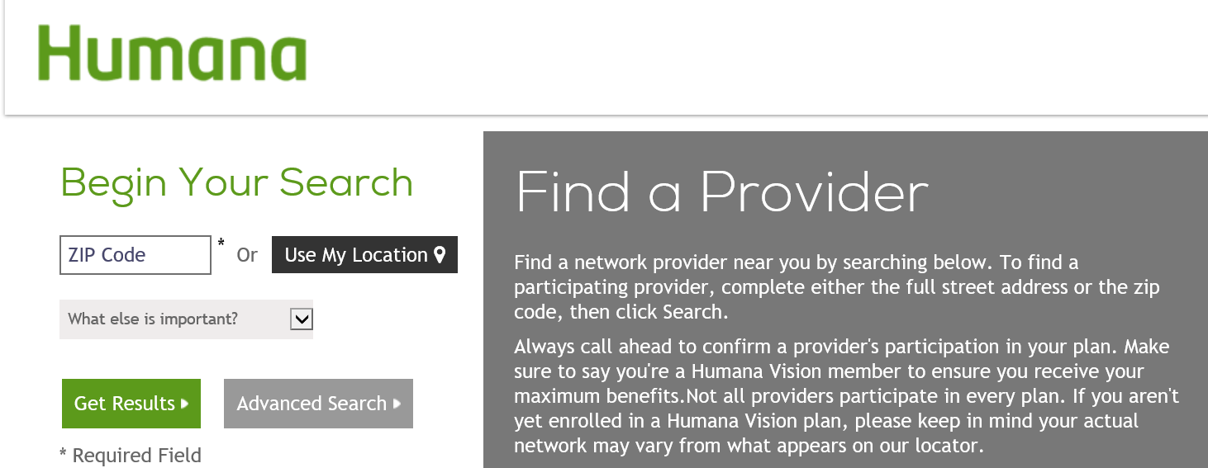
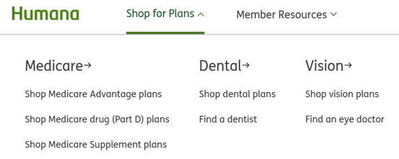
Vision provider search
1
GO TO HUMANA.COM
3
SELECT SEARCH CRITERIA
Choose “Find an eye doctor” under “Shop for Plans”
Click on the “Find a an eye doctor” button
Enter desired zip code
Click “Get Results”
2
SELECT “Humana Vision (Humana Insight Network)”
Notes:
For your vision provider search, there are three easy steps:
1. Go to humana.com. Under shop for plans tab, click Find an Eye Doctor.
2. Select the Humana Insight Network.
3. Enter the desired zip code for your area and click Get Results.

Slide 18

Member support
and resources
Notes:
Let's review the support and resources available to you as a Humana member

Slide 19




How members contact Humana
LIVE CALL
Customer Care hours: 7:30 a.m. to 11 p.m., Monday through Saturday, and Sunday 11am-8pm
INTERACTIVE VOICE
RESPONSE (IVR)
Members can access eligibility, claims status records, and benefits in the system via our IVR system 24 hours a day, seven days a week
Find the information you need online, or live chat with our Customer Care team
MyHUMANA
MyHUMANA
MOBILE APP
Our mobile app provides a number of self-serve options to access claim and benefit information, locate a provider, access ID card info, and more
Notes:
Humana offers a number of ways that you can contact us for assistance.
Our customer care team provides knowledgeable associates trained on the various vision benefits.
Our Interactive Voice Response, or IVR, system allows members 24 hour access to their benefits and eligibility.
The MyHumana website is your personalized member portal that provides easy access to your benefits, eligibility, claims, providers and ID cards. Your ID cards can be printed or emailed from this site.
The MyHumana mobile app is available on all smartphones and gives you the access to your benefits, eligibility and ID cards. Your ID card can be saved, shared or faxed from the mobile app.

Slide 20
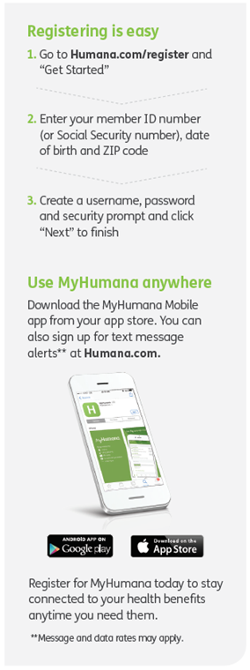
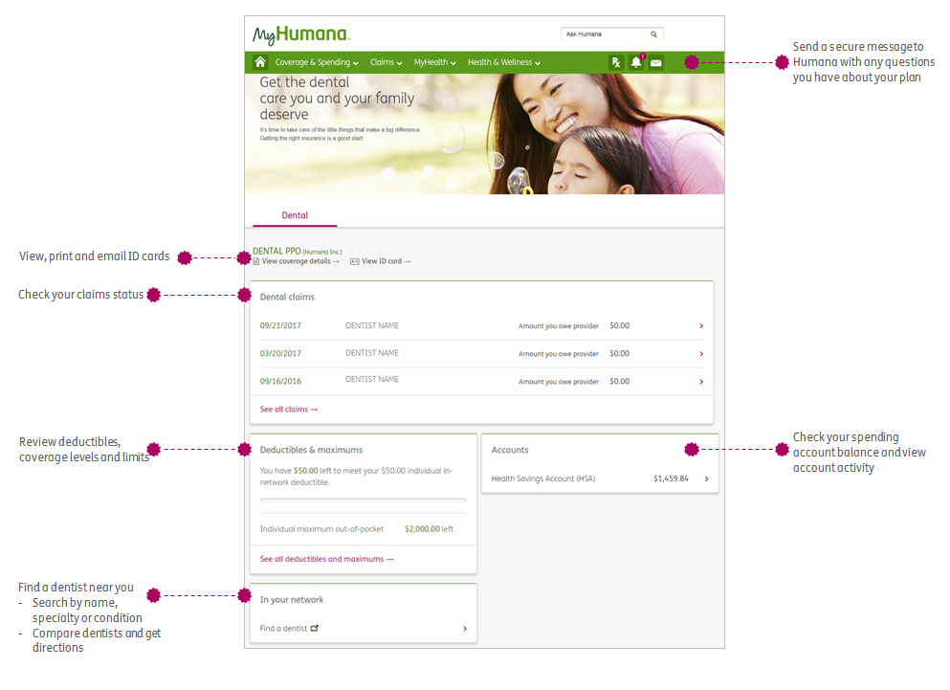
MyHUMANA: Personalized, secure member portal
Notes:
The myhumana website is a personalized and secure member portal. The website allows you 24 hour access to your benefits, eligibility, claims, providers and ID cards.
Each member of the plan over the age of 18 will need to register independently due to privacy reasons

Slide 21
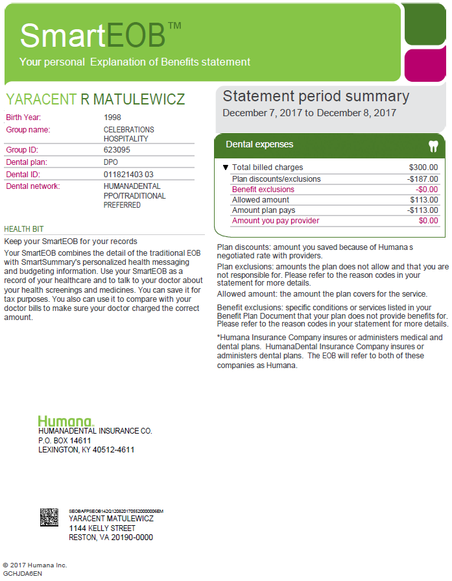
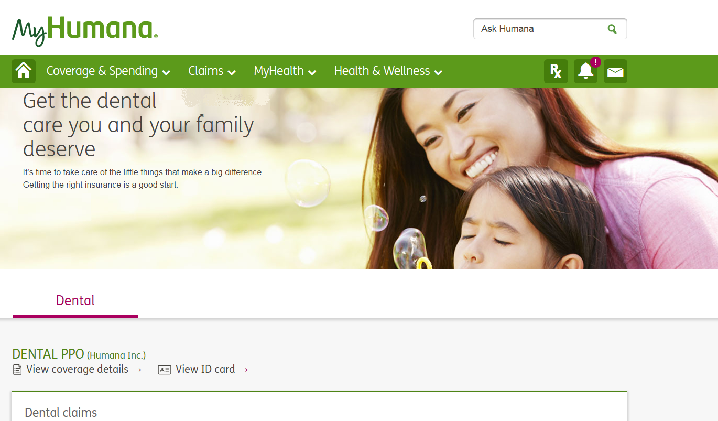

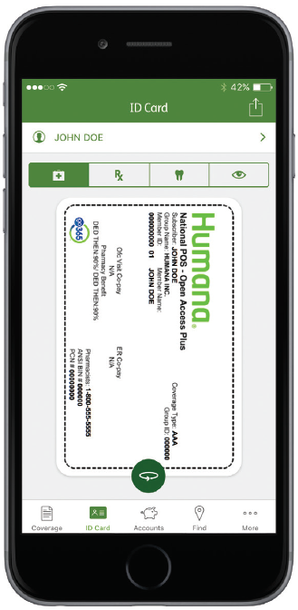
Ongoing member support
Smart EOB®
Humana.com
Mobile support
My Dental IQ℠
Notes:
Members have a number of resources available through Humana's online support system.
Smart EOBs are generated for each claim processed. This gives you an overall picture of how and why the claim was processed and information to continue on your path to good oral health.
Humana.com and the myhumana mobile application are both bringing the ease of knowing your questions can be answered at your fingertips.
The My Dental IQ is an education tool that provides more detail and insight to good oral health and allows you to take a quiz to see what your Dental IQ is.

Slide 22
Customer Care
If you have any questions, contact:
Medical/Provider Service: 1-866-427-7478
Vision Member/Patient Services: 1-877-398-2980

Slide 23
This communication provides a general description of certain identified insurance or non-insurance benefits provided under one or more of our health benefit plans. Our health benefit plans have exclusions and limitations and terms under which the coverage may be continued in force or discontinued. For costs and complete details of the coverage, refer to the plan document or call or write Humana, or your Humana insurance agent or broker. In the event of any disagreement between this communication and the plan document, the plan document will control.
Limitations on telehealth services, also referred to as virtual visits or telemedicine, vary by state. These services are not a substitute for emergency care and are not intended to replace your primary care provider or other providers in your network. Any descriptions of when to use telehealth services are for informational purposes only and should not be construed as medical advice. Please refer to your evidence of coverage for additional details on what your plan may cover or other rules that may apply.
Go365 is not an insurance product and is not available with all Humana health plans. This is a general description of services which are subject to change. Please refer to Customer Support for more information.
These non-insurance services are provided by Humana EAP and Work-Life Services/Humana Wellness. This is a general description of services which are subject to change. Please refer to your Human Resources contact for more information.
Dental PPO Plans are not offered in all states
In Texas, this plan provides benefits for contracted and non-contracted dentists. Non-contracted dentists have not agreed to provide services at contracted fees. If a member sees a non-contracted dentist their out of pocket costs may be higher than that charged by contracted dentists.
Offered by Humana Medical Plan, Inc. or Insured by Humana Health Insurance Company of Florida, Inc.
Statements in languages other than English contained in the advertisement do not necessarily reflect the exact contents of the policy written in English, because of possible linguistic differences. In the event of a dispute, the policy as written in English is considered the controlling authority.
Please refer to your Benefit Plan Document (Certificate of Coverage/Insurance or Summary Plan Description/Administrative Services Only) for more information on the company providing your benefits.
Our health benefit plans have exclusions and limitations and terms under which the coverage may be continued in force or discontinued. For costs and complete details of the coverage, call or write your Humana insurance agent or broker.
Humana group vision plans are insured by Humana Insurance Company and dental plans are insured or administered by Humana Insurance Company.

Slide 24
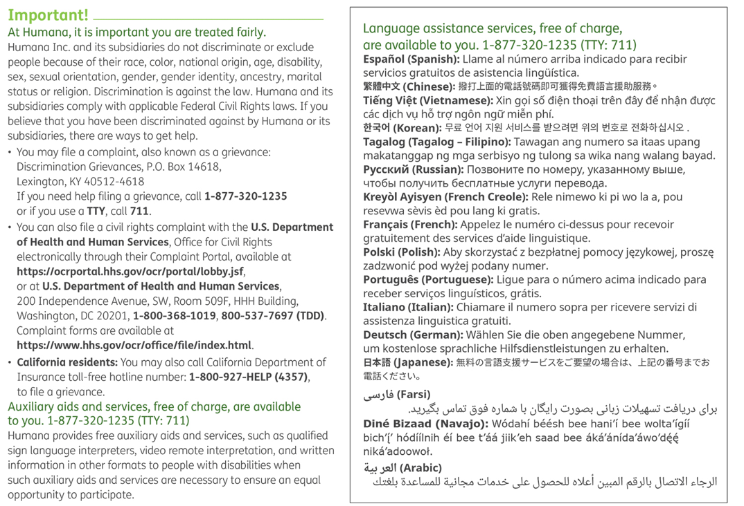
FLHKW8BEN
Notes:
(Must remain on all presentations)

